Slide 1
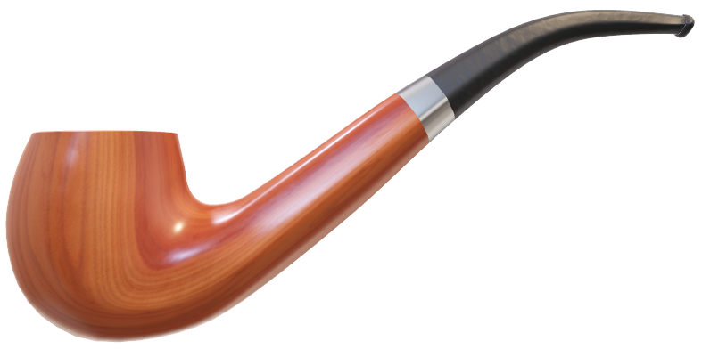
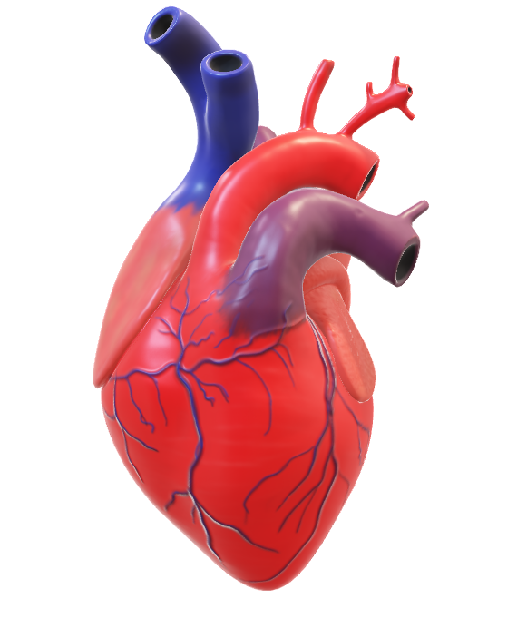
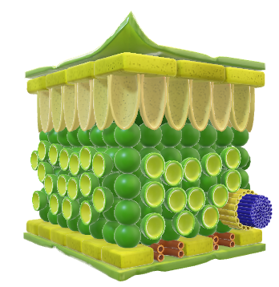
Binary Prediction of Smoker Status using Bio-Signals
Team Explorers
DataSource
Walter Reade, Ashley Chow. (2023). Binary Prediction of Smoker Status using Bio-Signals. Kaggle. https://kaggle.com/competitions/playground-series-s3e24

Slide 2
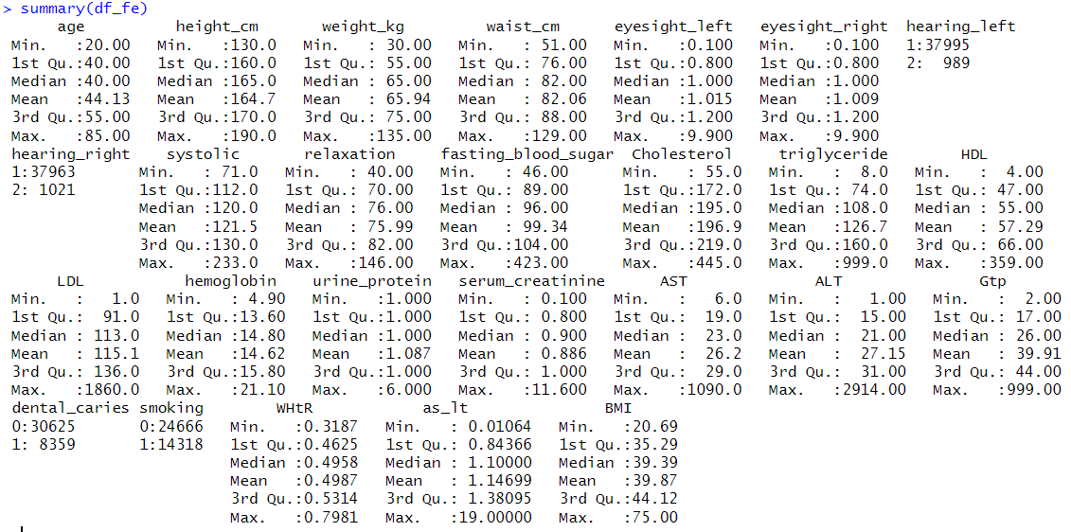
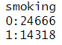
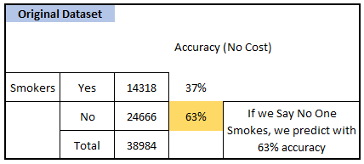
Can We Do Better than this ?

Slide 3
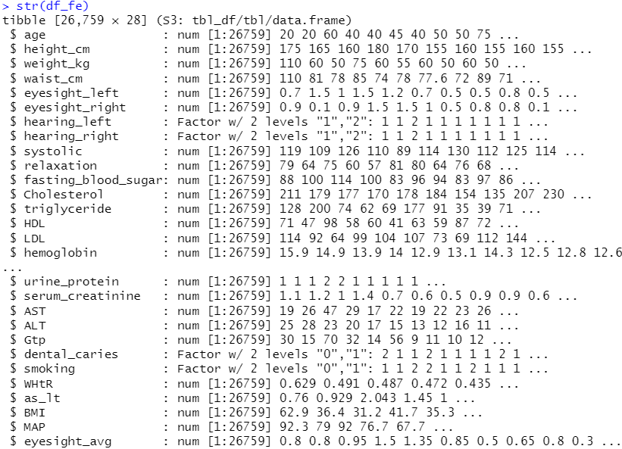
Available Data Variables and Featured Data Variables
Original Features
Target
Engineered Features

Slide 4
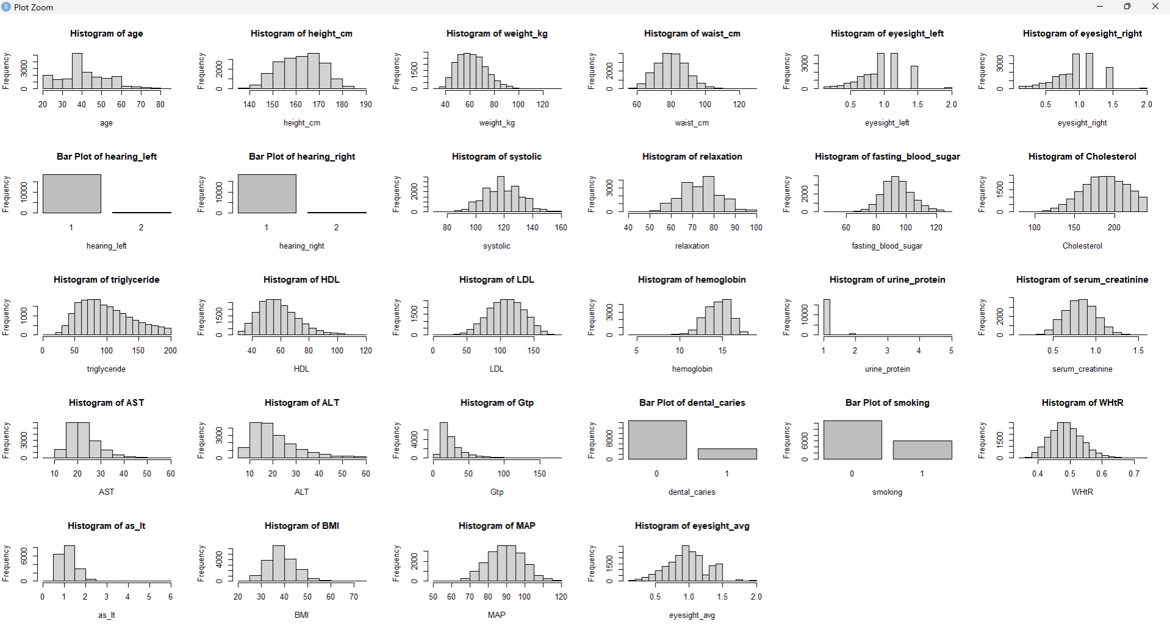
What Happens when we Removed Outliers ?

Slide 5
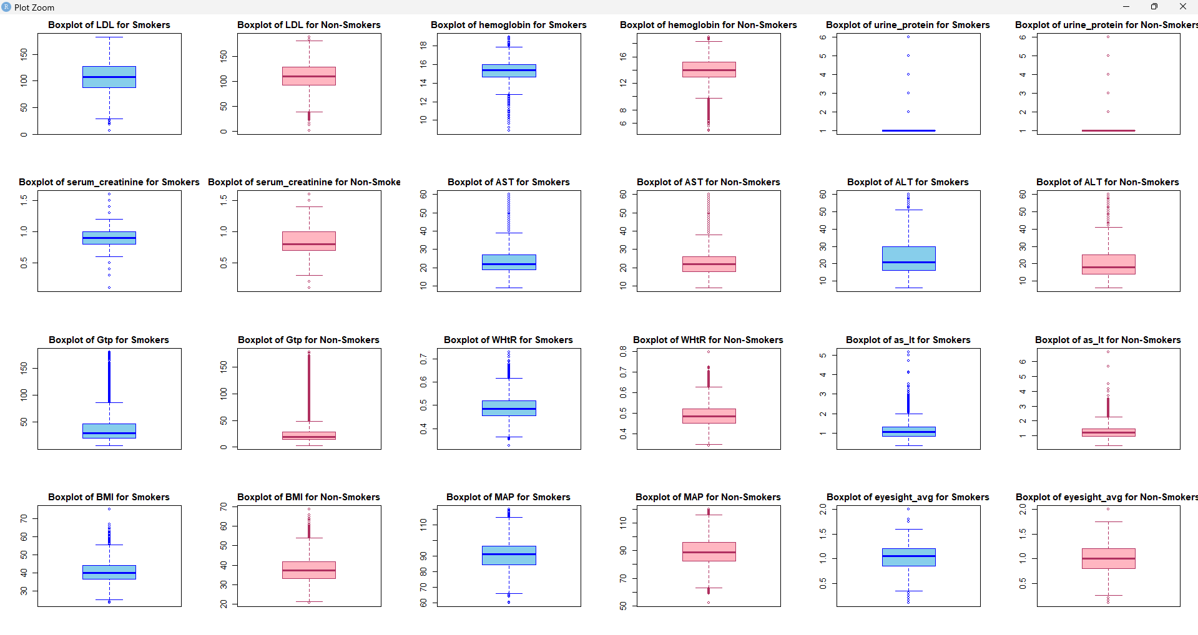

Slide 6
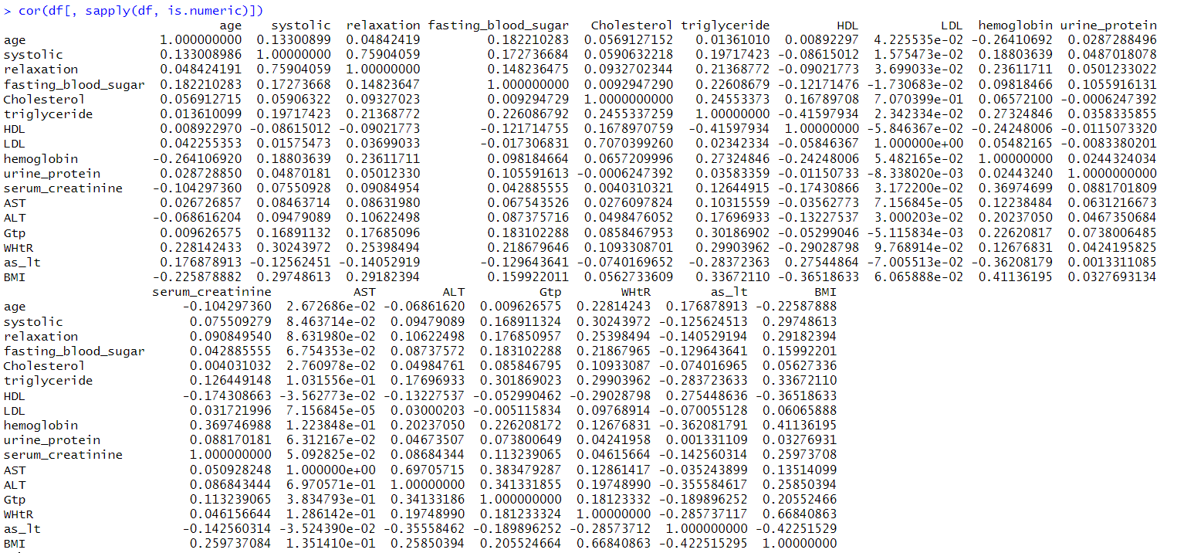




































Data Correlations Before Removing Outliers
Yellow -> Autocorrelations (Diagonal)
Blue -> >=40% Correlations
Pink -> >=30% Correlations

Slide 7
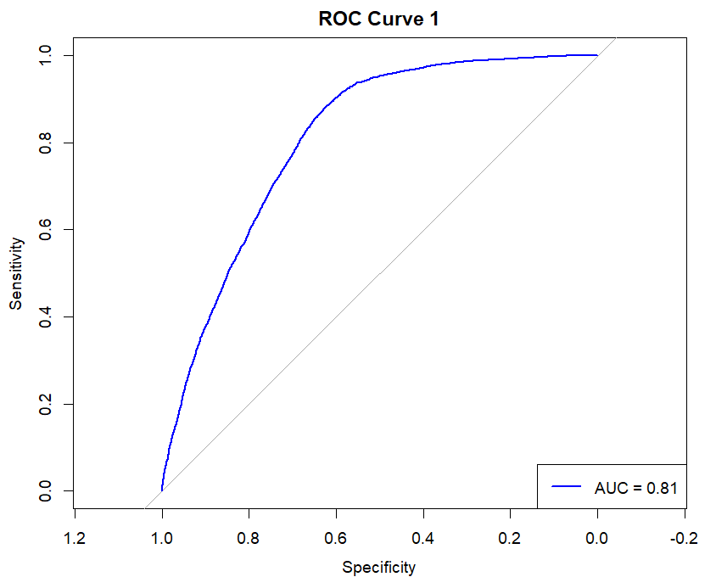
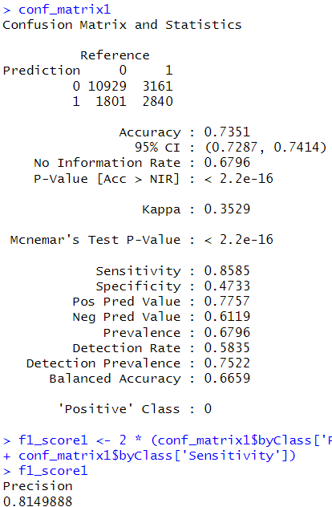
glm.fits1
Fit the Model on all parameters
Boom
Did Nothing and Accuracy ~ 73%
AUC ~ 81.5%

Slide 8
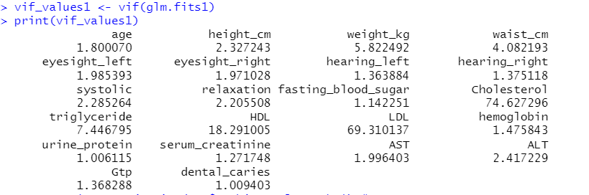
But Who will take Consideration of the Inflated Variation ?

Slide 9
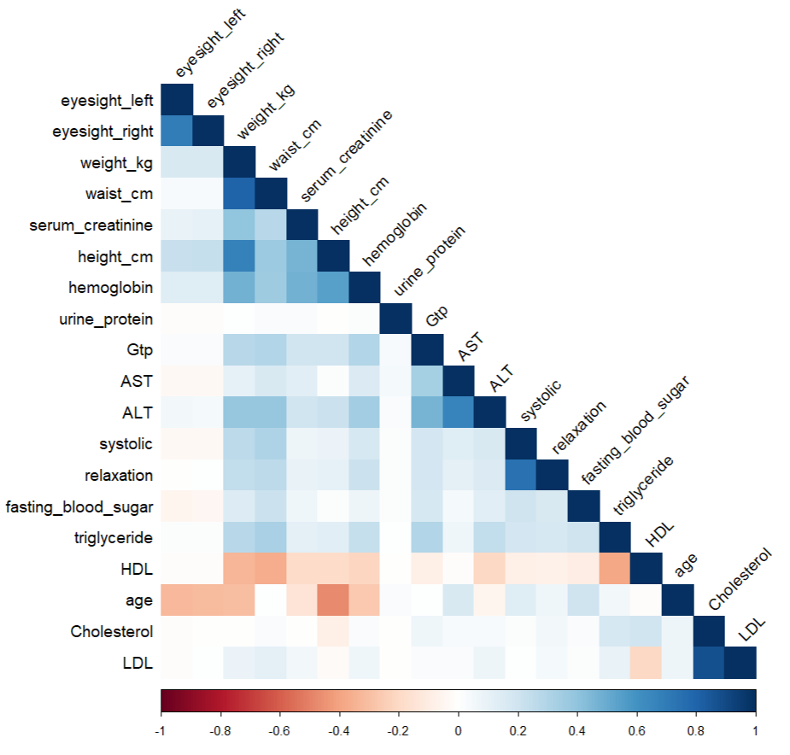
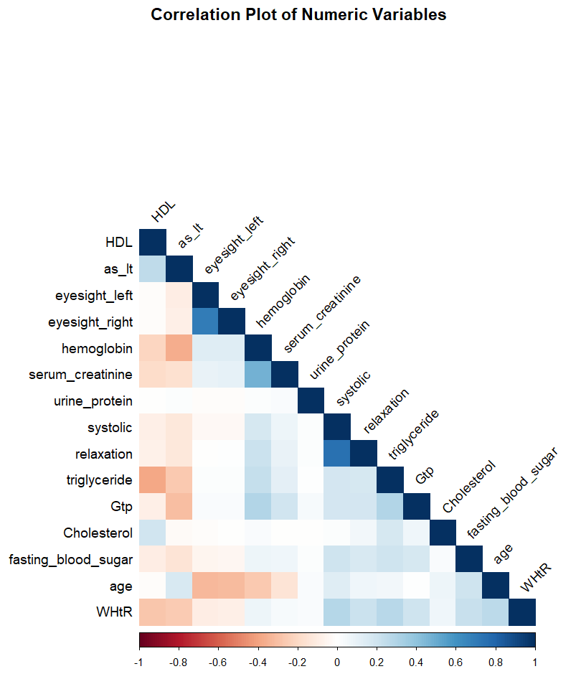
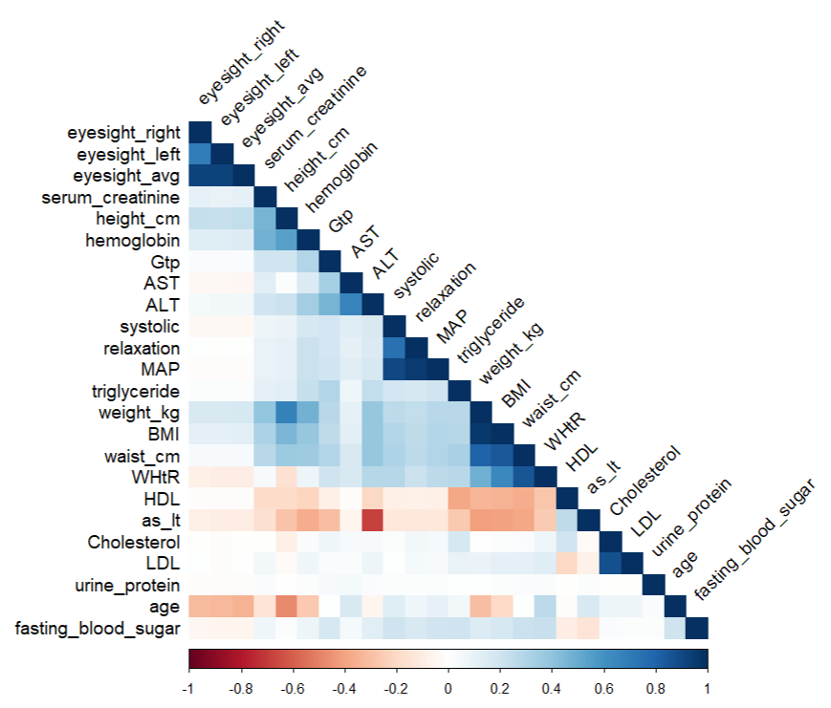
Correlation Matrix of Numeric Variables in Training Data

Slide 10
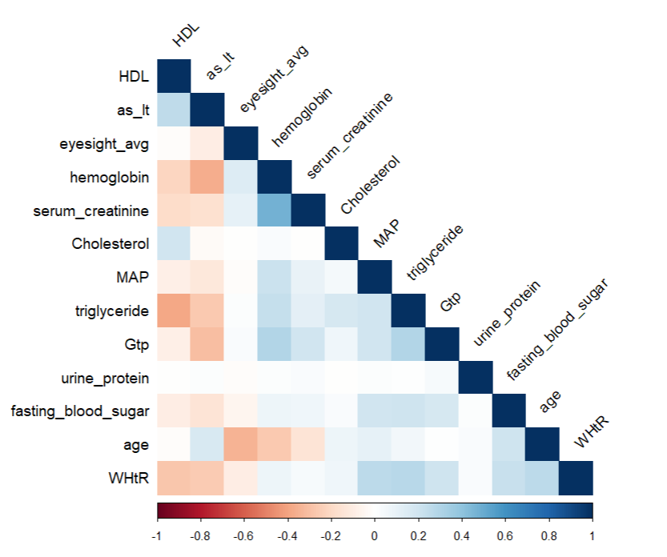
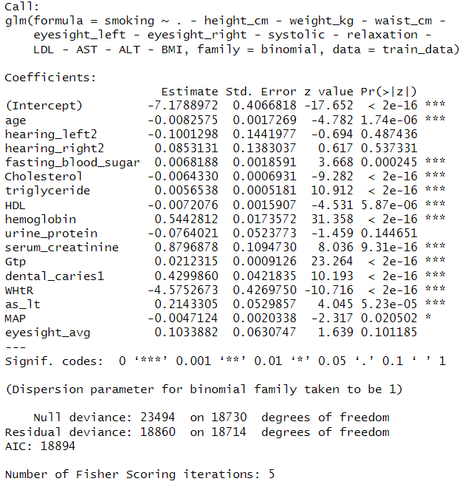
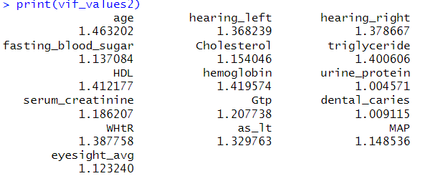
glm.fits2 – Fit Model on Selected Parameters (Removing Multicollinearity)
Correlation Matrix of Fitted Variables

Slide 11
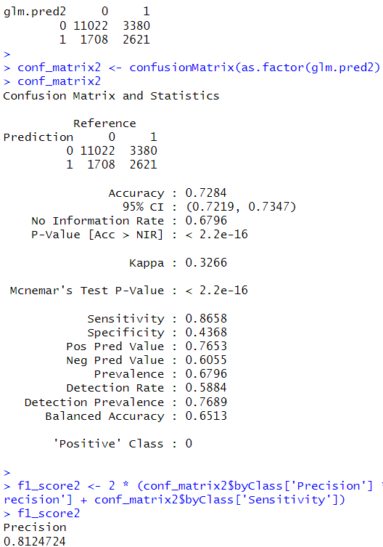
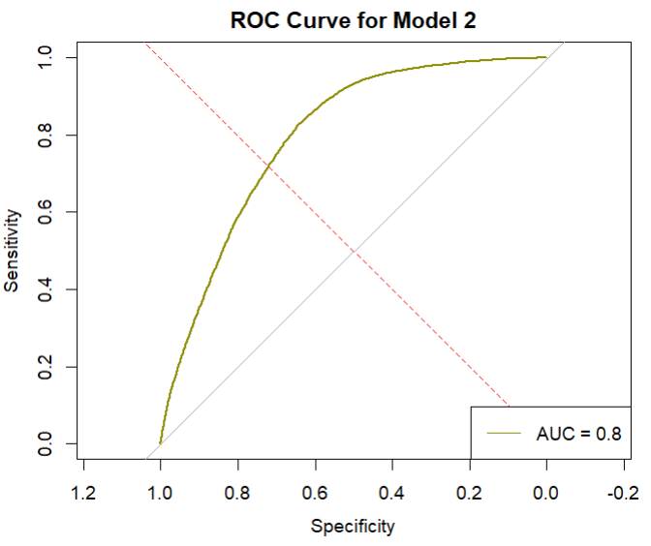

Slide 12
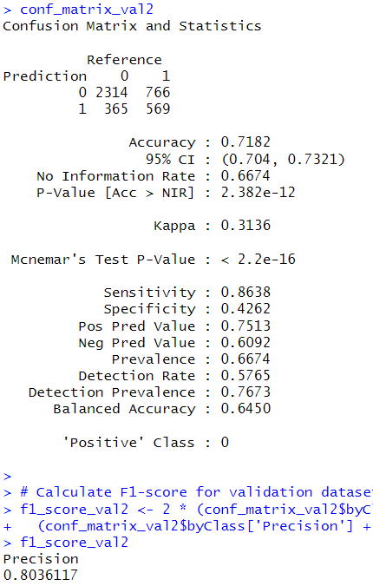
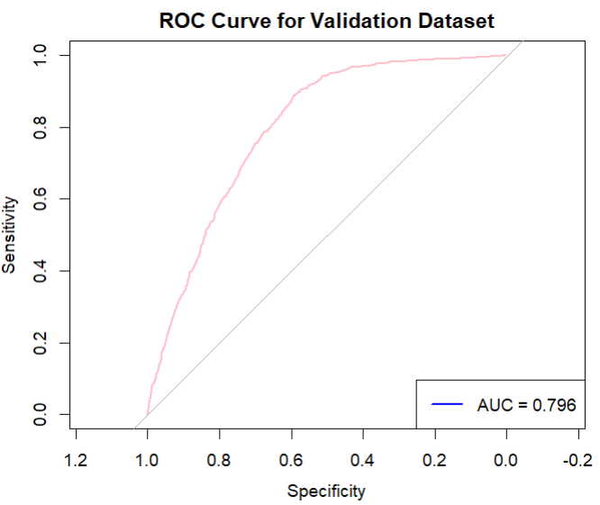

Slide 13
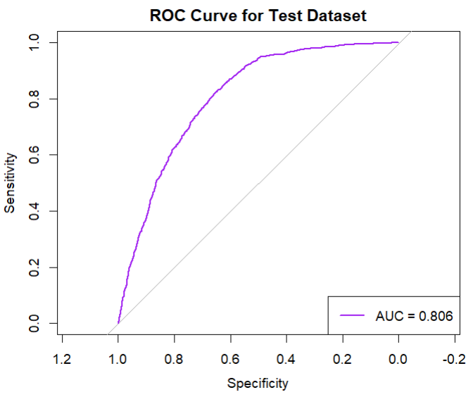
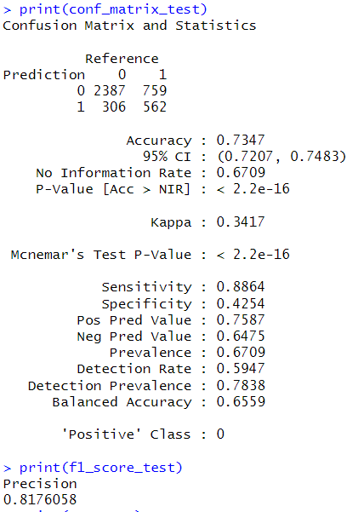

Slide 14
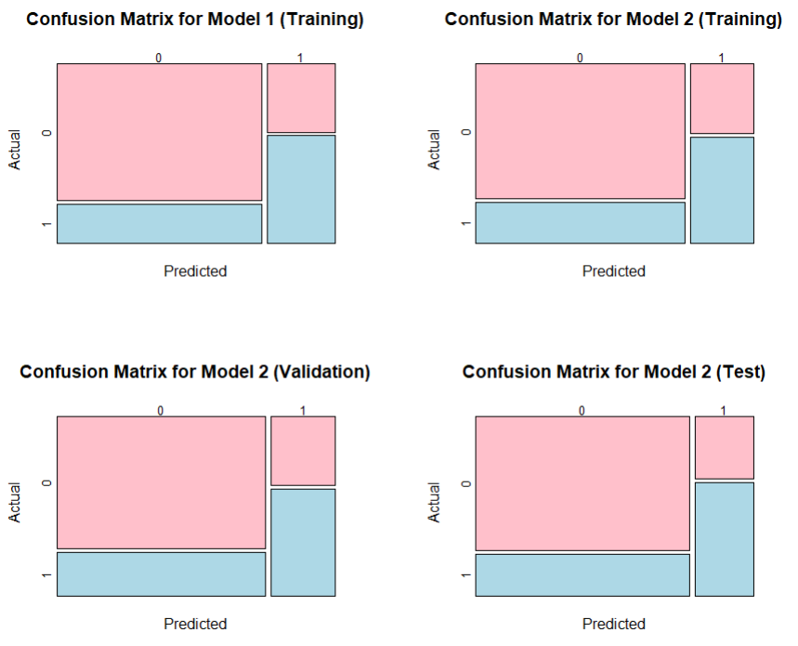
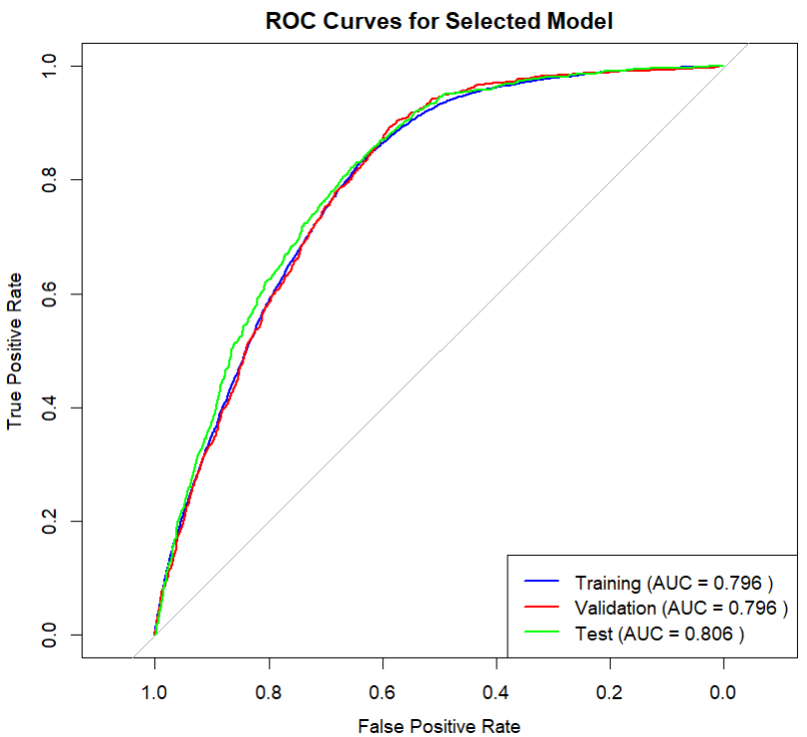

Slide 15
Appendix

Slide 16
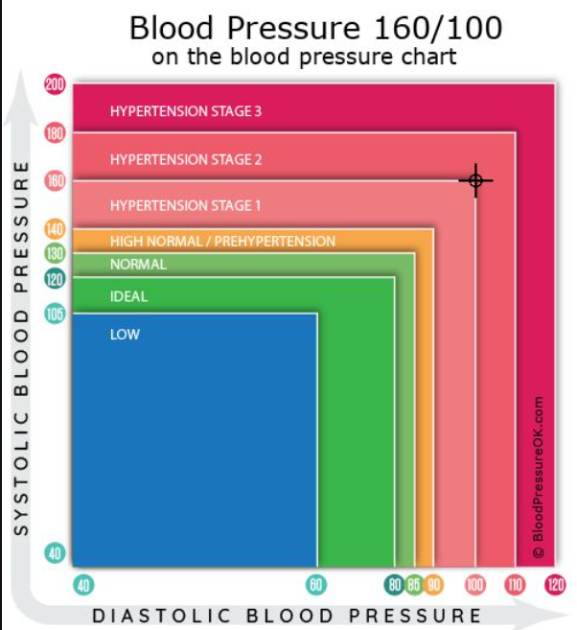
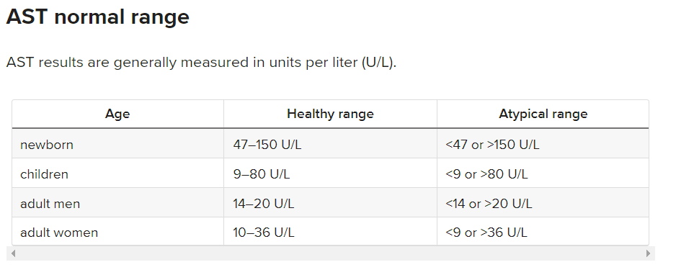
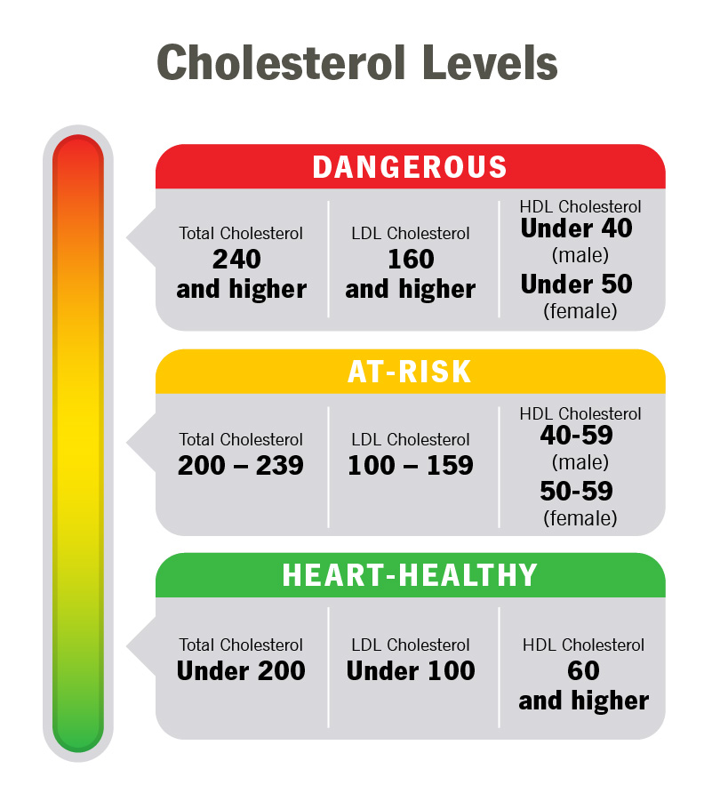
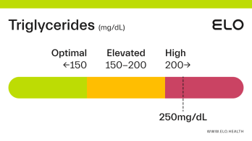

Cholesterol Levels are Averaged Out for Males and Females
Total Cholesterol –
240+ - Dangerous
200-239 -> At Risk
< 200 -> Healthy
LDL
160+ - Dangerous
100 – 159 -> At Risk
< 100 -> Healthy
HDL
< 45 - Dangerous
45 – 60 > At Risk
60+ -> Healthy
Source: https://my.clevelandclinic.org/health/articles/11920-cholesterol-numbers-what-do-they-mean
Triglycerides Levels
200+ - Dangerous
150-200 -> At Risk
< 150 -> Healthy

Slide 17
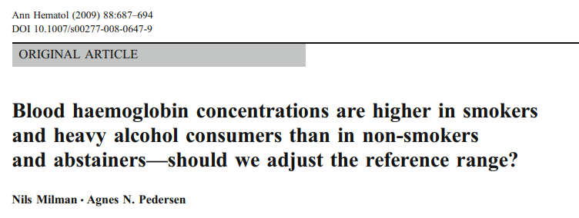
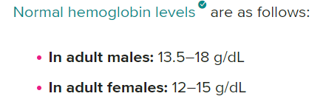
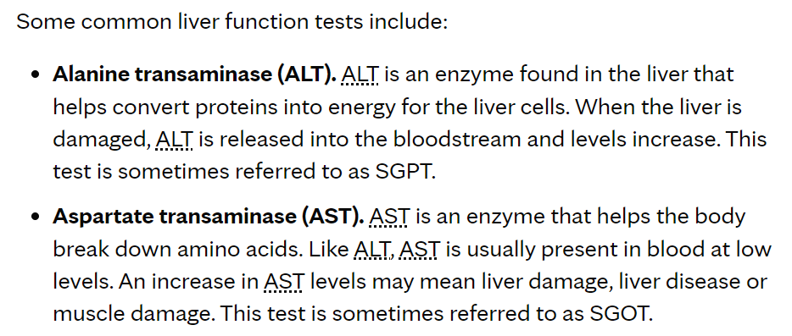
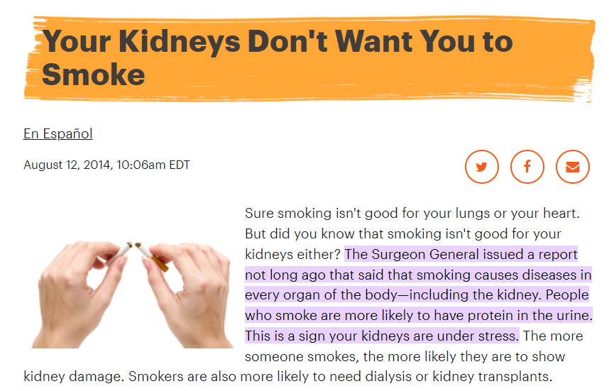
Source: https://hal.science/hal-00535009/document
Source: https://www.mayoclinic.org/tests-procedures/liver-function-tests/about/pac-20394595#:~:text=Standard%20range%20blood%20test%20results,8%20to%2048%20U%2FL%20
Source: https://www.kidney.org/news/kidneyCare/winter09/DontSmoke#:~:text=The%20Surgeon%20General%20issued%20a,your%20kidneys%20are%20under%20stress

Slide 18
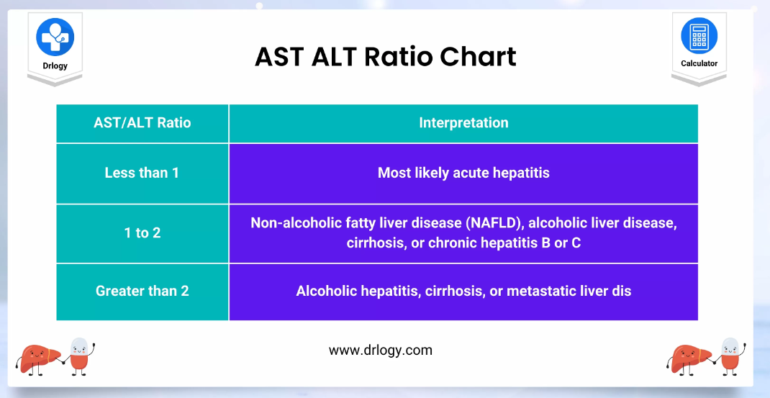
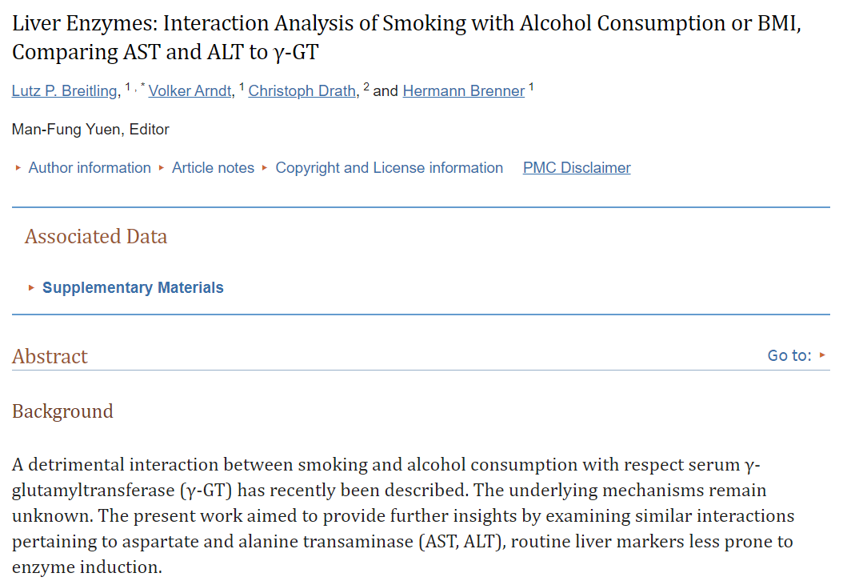
Source: https://drlogy.com/calculator/ast-alt-ratio
Source: https://www.ncbi.nlm.nih.gov/pmc/articles/PMC3222662/

Slide 19
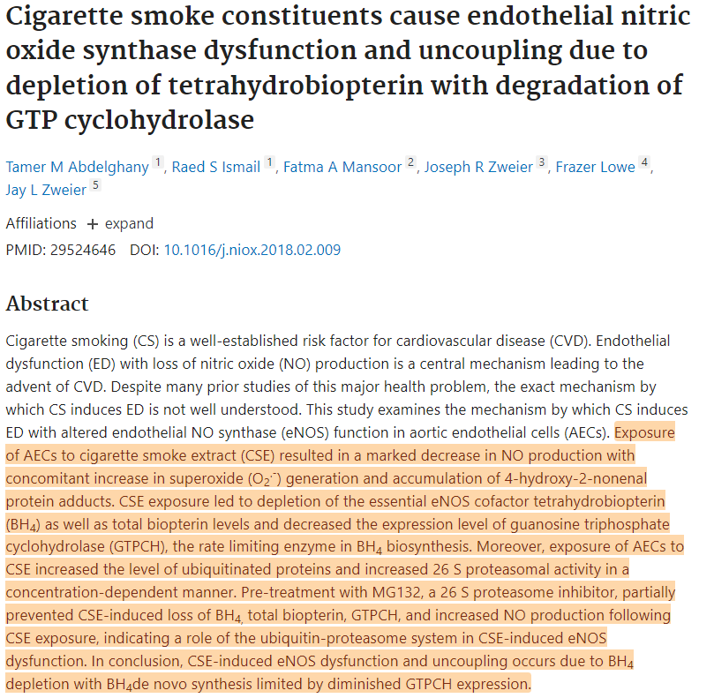
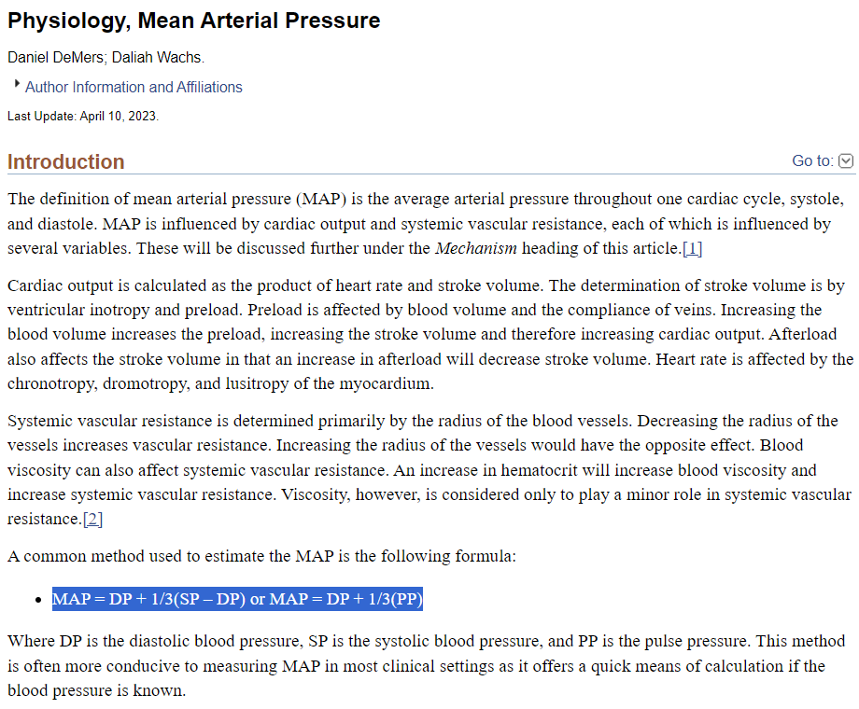
Source: https://pubmed.ncbi.nlm.nih.gov/29524646/
Source: https://www.ncbi.nlm.nih.gov/books/NBK538226/

